Slide 1
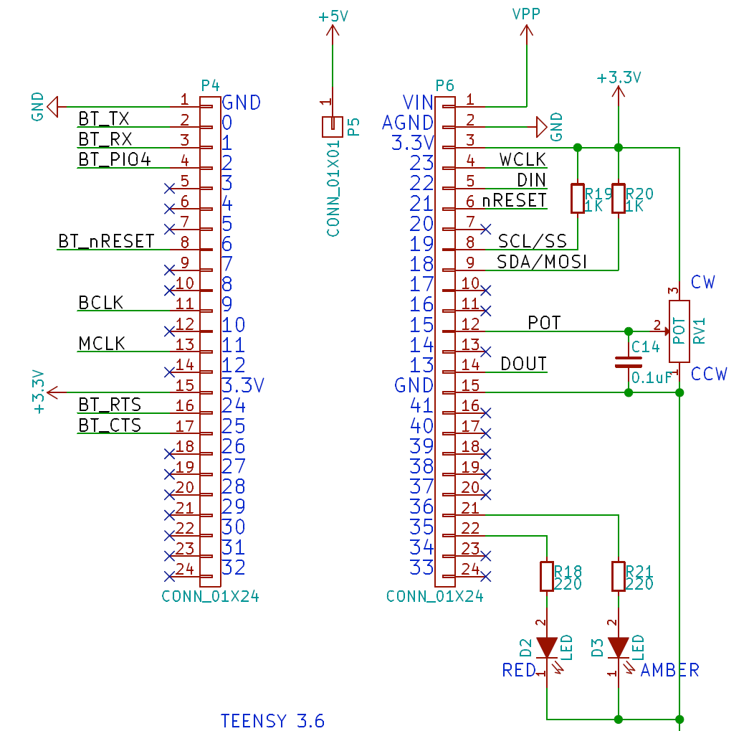
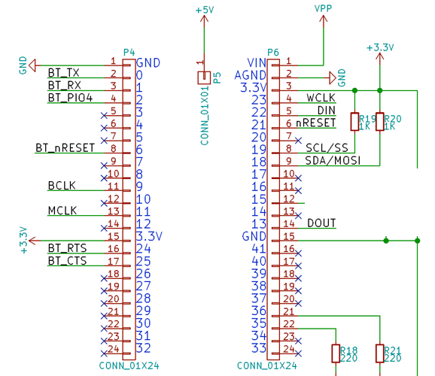
Tympan Rev C
Original
Tympan Rev C
Modified for 2 AICs
Can be any pin, really
SCL2 (AIC #2)
SDA2 (AIC #2)
nRESET1 (AIC#2)
Can be any analog pin
Pot Wiper
TXD1 (“DIN” AIC#2)
RXD1 (“DOUT” AIC#2)
TXD1 is PTC0
RXD1 is PTC11

Slide 2
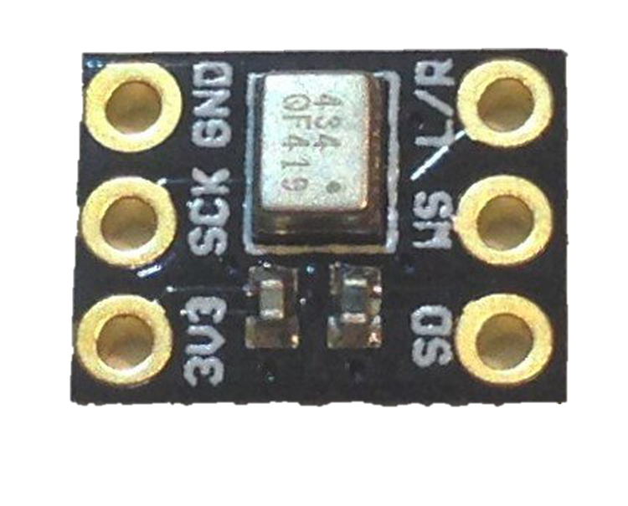
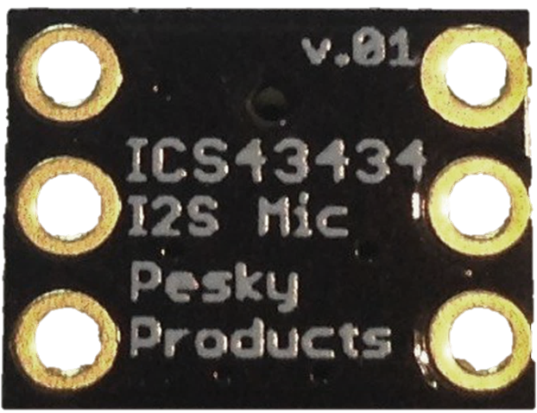
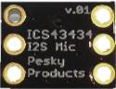
L/R
GND
WS
SCK
SD
3V3

Slide 3
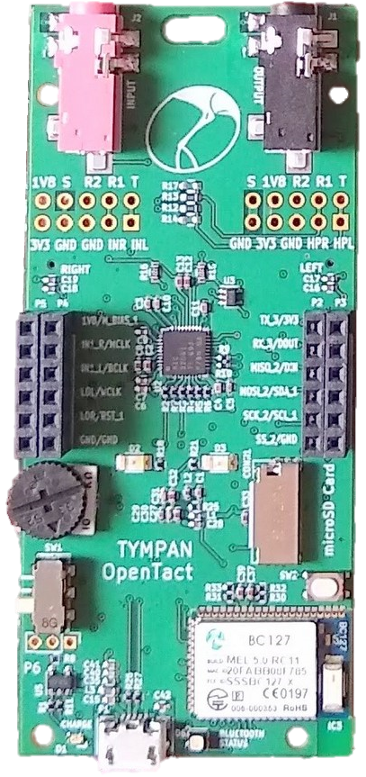
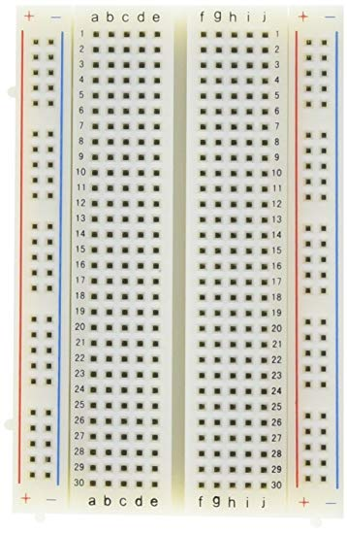
L/R
GND
WS
SCK
SD
3V3
L/R
GND
WS
SCK
SD
3V3

